Slide 1
☀
SKYLINE WEATHER
A Production-Quality Full-Stack Weather Application
React (Vite) + Node.js / Express + OpenWeatherMap API
Class Presentation

Slide 2
What the App Does
Core capabilities delivered end to end, from search to display
🔍
📍
🌡️
Search by City
Use My Location
Full Conditions
Look up current conditions for any city name
Browser Geolocation API pulls weather for wherever you are
Temp, feels-like, humidity, wind, pressure, visibility, sunrise/sunset
📅
⭐
🌗
5-Day Forecast
Favorites & History
Dark / Light Mode
Forward-looking outlook alongside current conditions
Star cities and revisit recent searches, saved in Local Storage
Instant theme toggle with dynamic weather-based gradients
Skyline Weather | Full-Stack Weather App
2

Slide 3
System Architecture
A classic client-server design keeps the API key private
React Frontend
Express Backend
OpenWeatherMap API
Vite dev server
UI, state, Local Storage
Never sees the API key
HTTP requests to /api/...
Thin proxy + gatekeeper
Holds the secret API key
Routes, controllers, services
Axios + appid
External weather data
Current conditions
5-day forecast
The frontend never talks to OpenWeatherMap directly — the backend calls it server-side, keeping the API key out of the browser and leaving room for caching or rate-limiting later.
Skyline Weather | Full-Stack Weather App
3

Slide 4
Project Structure
Two independent apps, cleanly separated by responsibility
⚛
client/ — React (Vite)
🖥
server/ — Node.js + Express
api/ — shared Axios instance
components/ — SearchBar, WeatherCard, Forecast, Loader, ThemeToggle, FavoriteCities, SearchHistory
context/ — ThemeContext (dark/light)
hooks/ — useWeather (data fetching)
utils/ — formatting + theme helpers
App.jsx, App.css, index.css, main.jsx
config/ — env-based configuration
controllers/ — request handlers
middleware/ — centralized error handler
routes/ — API route definitions
services/ — OpenWeatherMap API calls
index.js — Express app entry point
Skyline Weather | Full-Stack Weather App
4

Slide 5
Data Flow — Searching "Paris"
One user action, eight steps, top to bottom
1
User types "Paris" and clicks Search in SearchBar.jsx
5
Express routes the requests to weatherController.js
2
SearchBar calls onSearch → handleSearch() in App.jsx
6
Controller calls weatherService.js, which calls OpenWeatherMap with the secret API key
3
handleSearch calls fetchWeatherByCity("Paris") from useWeather hook
7
JSON flows back up: OpenWeatherMap → service → controller → response → Axios → hook state
4
Hook sets loading = true, calls GET /api/weather & /api/forecast via shared Axios instance
8
React re-renders WeatherCard and Forecast with the new data
Skyline Weather | Full-Stack Weather App
5

Slide 6
State Management
No Redux needed — built-in React tools cover it all
useState
Local component state for inputs and dropdown visibility
useWeather (custom hook)
Server data, loading, and error state — reusable and testable
React Context
ThemeContext holds the one truly global piece of state (dark/light mode)
Local Storage
Persists history, favorites, and theme; read on mount, written on change
Data flows down via props; events flow up via callback props (e.g. onSearch, onToggleFavorite) — one-directional and predictable.
Skyline Weather | Full-Stack Weather App
6

Slide 7
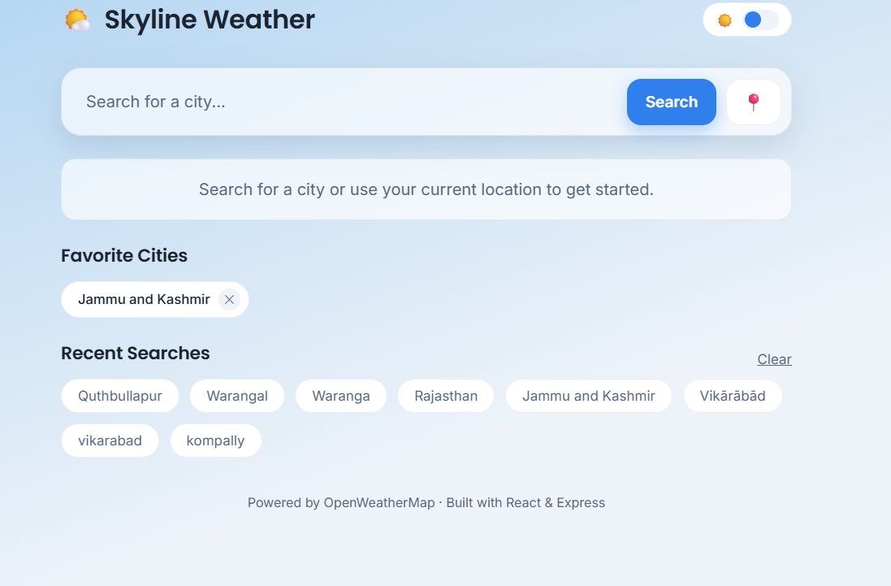
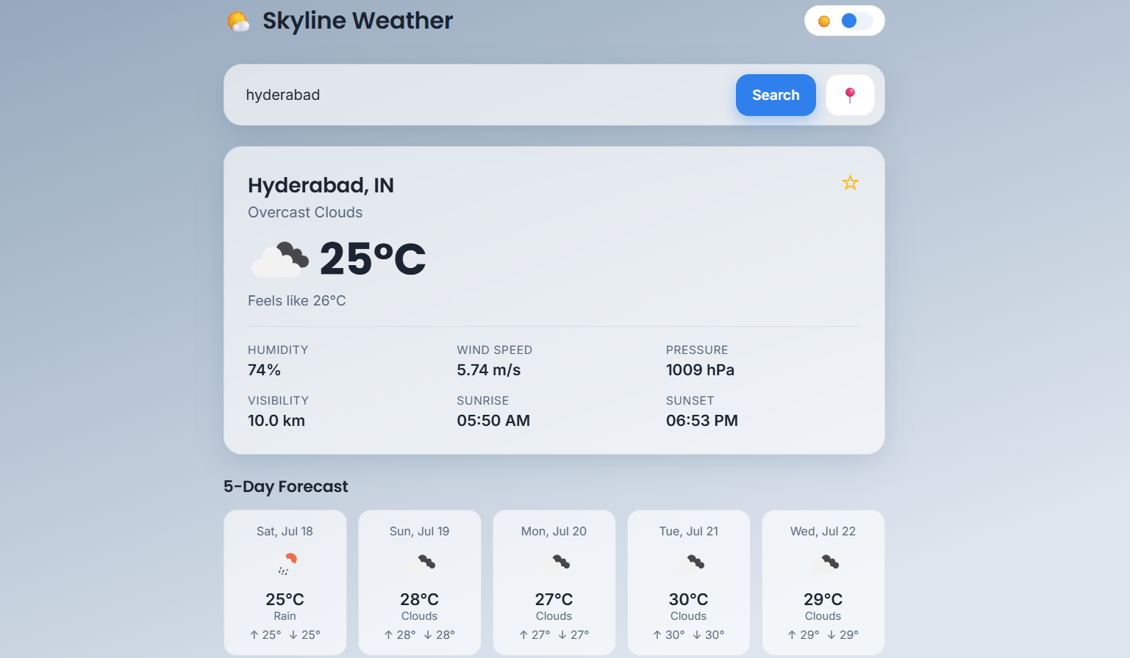
The App in Action
Empty state with favorites & history, plus a full weather result with 5-day forecast
Home — search, favorites & recent history
Result view — current conditions & 5-day forecast
Skyline Weather | Full-Stack Weather App
Skyline Weather | Full-Stack Weather App
7

Slide 8
Setup, Testing & Deployment
From local dev to a live, deployed app
🔑
Environment Variables
✓
Testing Checklist
🚀
Deployment
server/.env
OPENWEATHER_API_KEY, PORT,
OPENWEATHER_BASE_URL
client/.env
VITE_API_BASE_URL — the VITE_ prefix exposes it to frontend code
Valid city search returns weather + forecast
Invalid city shows a friendly error, not a crash
Geolocation loads weather for current position
Favorites persist after a page refresh
Recent searches populate the history list
Dark mode toggle persists on reload
Layout adapts down to mobile widths
Backend
Render / Railway / Fly.io / Heroku — build: npm install, start: npm start
Frontend
Vercel / Netlify / GitHub Pages — build: npm run build, output: dist
CORS
Restrict cors() to the deployed frontend origin in production
Skyline Weather | Full-Stack Weather App
8

Slide 9
Future Improvements
Where the project could go next
🧪
Automated Tests
📈
Hourly Forecast Charts
🌫️
Air Quality Index
Jest + React Testing Library on the frontend, Supertest for backend routes
Visualize hour-by-hour trends with Chart.js or Recharts
Pull AQI data via OpenWeatherMap's Air Pollution API
🔤
City Autocomplete
📴
Offline Support (PWA)
⚡
Response Caching
Use the Geocoding API to suggest cities while typing
Add a service worker for installability and offline use
Redis-based caching to cut repeat OpenWeatherMap calls
Skyline Weather | Full-Stack Weather App
9

Slide 10
☀
Thank You
Skyline Weather — React, Express, and OpenWeatherMap working together
Questions?

